Slide 1





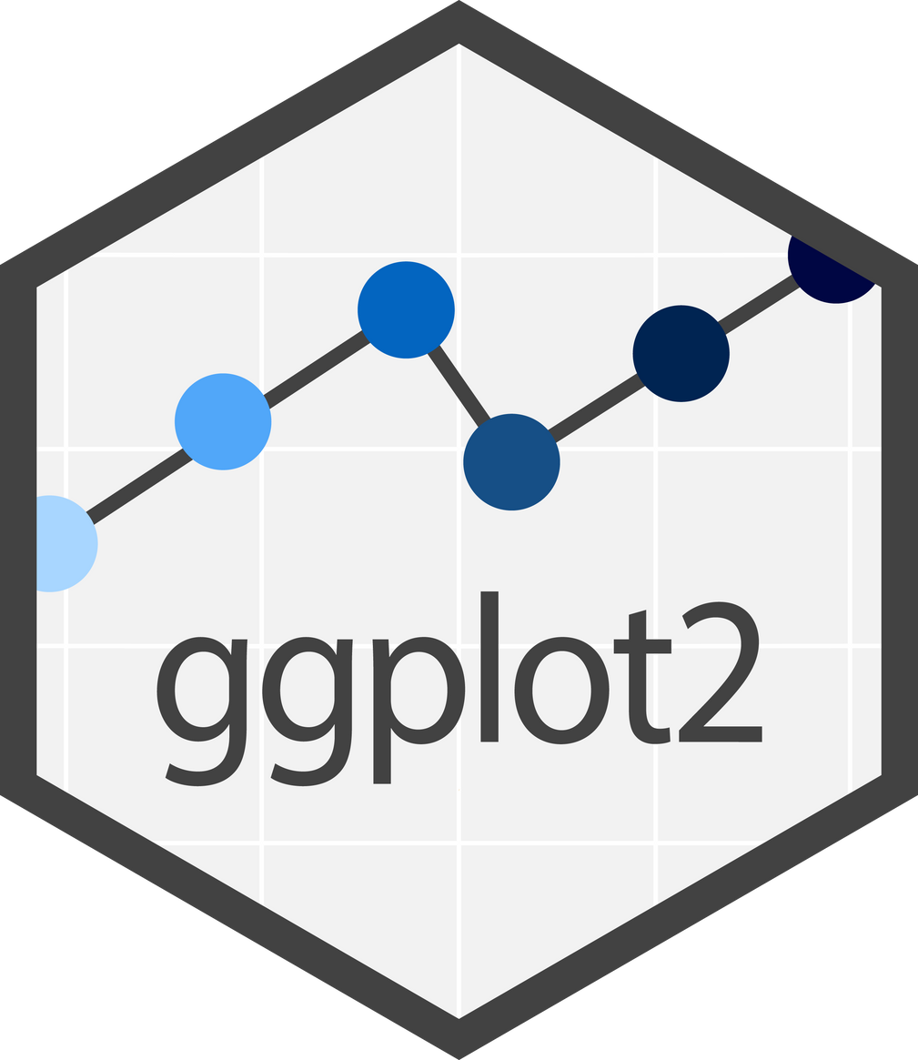


CODING CLUB 11/2
DATA VISUALIZATION
WITH GGPLOT2
CHARLOTTE & HELEEN

Slide 2

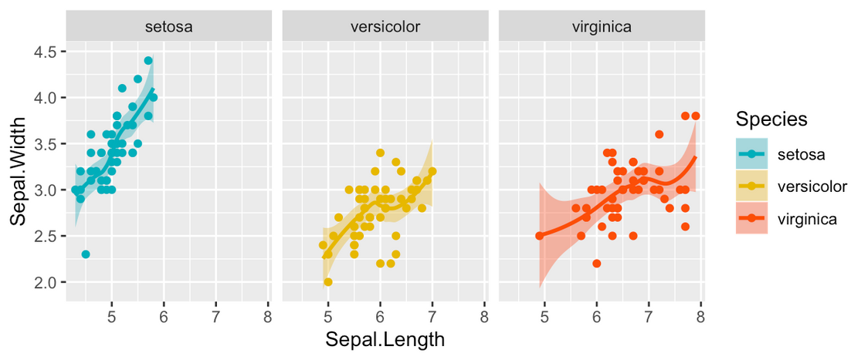

OVERVIEW
Part 1: Introduction
Part 2: Basics & highlights
Part 3: Common errors & issues
Part 4: Your turn!

Slide 3

ASKED QUESTIONS (GOOGLE FORM)
confidence intervals, plot predicted values based on model?
What types of plots/graphs exist in this endless world of statistics?
combining information on multiple parameters (usually one on the x-axis, one providing a different color, one or two factors to divide the plot in panels)
combining multiple plots in the same figure

Slide 4
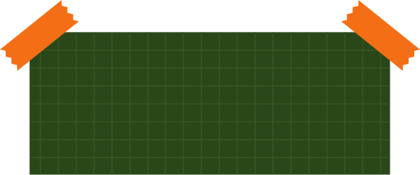

PART 1
INTRODUCTION

Slide 5

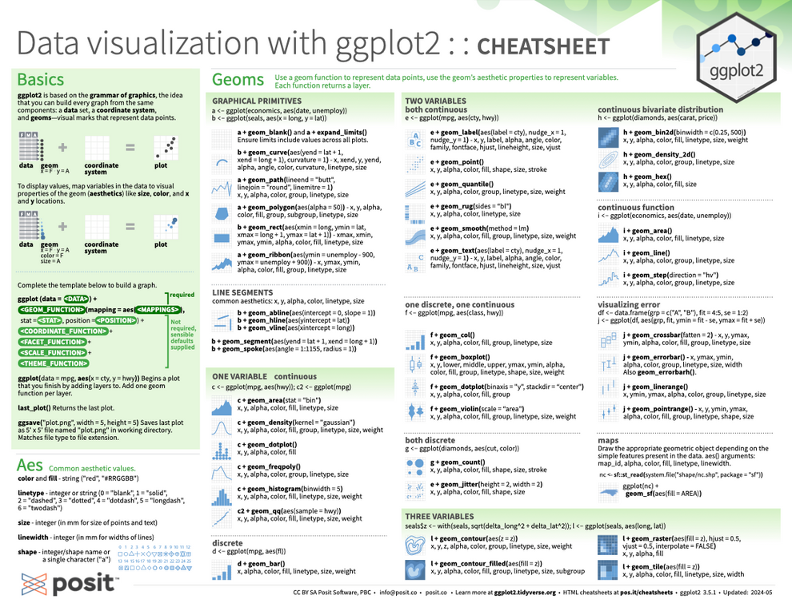
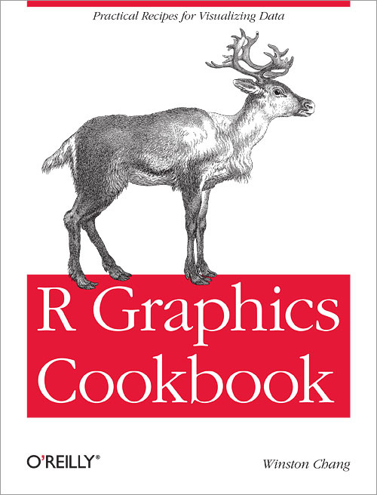

2016 (Wickham et al.)
tidyverse!
very tightly coupled to dplyr
intuitive syntax (+ instead of %>%)

Slide 6

A GOOD GRAPH
GGPLOT2
GOOD UNDERSTANDING OF YOUR DATA

Slide 7
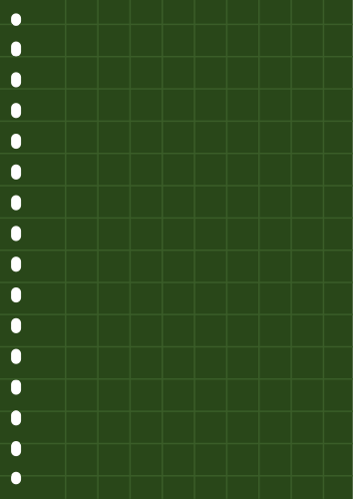


PART 2
BASICS
&
HIGHLIGHTS

Slide 8

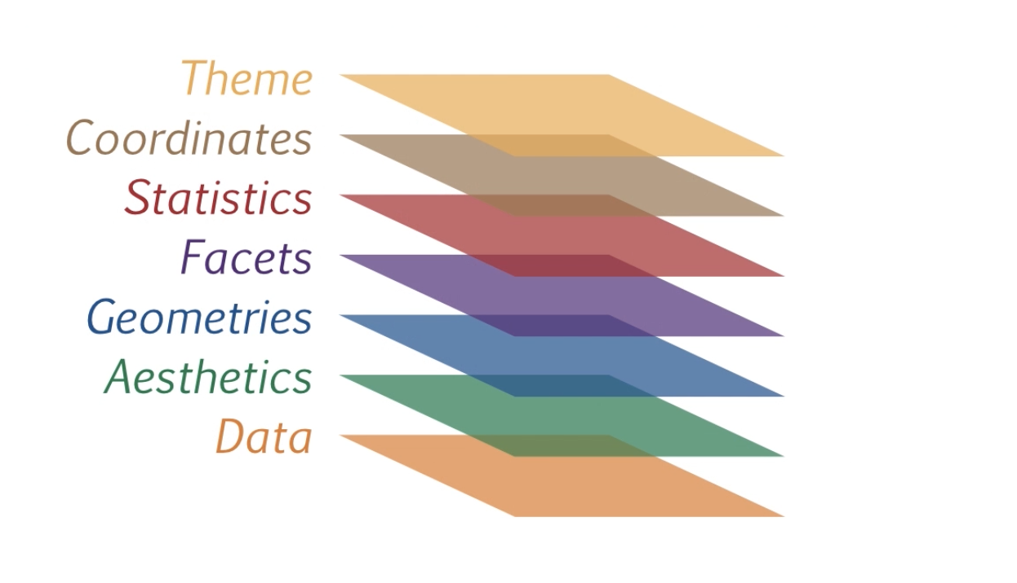
GENERAL STRUCTURE
BASED ON THE GRAMMAR OF GRAPHICS:
THE IDEA THAT YOU CAN BUILD EVERY GRAPH FROM THE SAME COMPONENTS

Slide 9
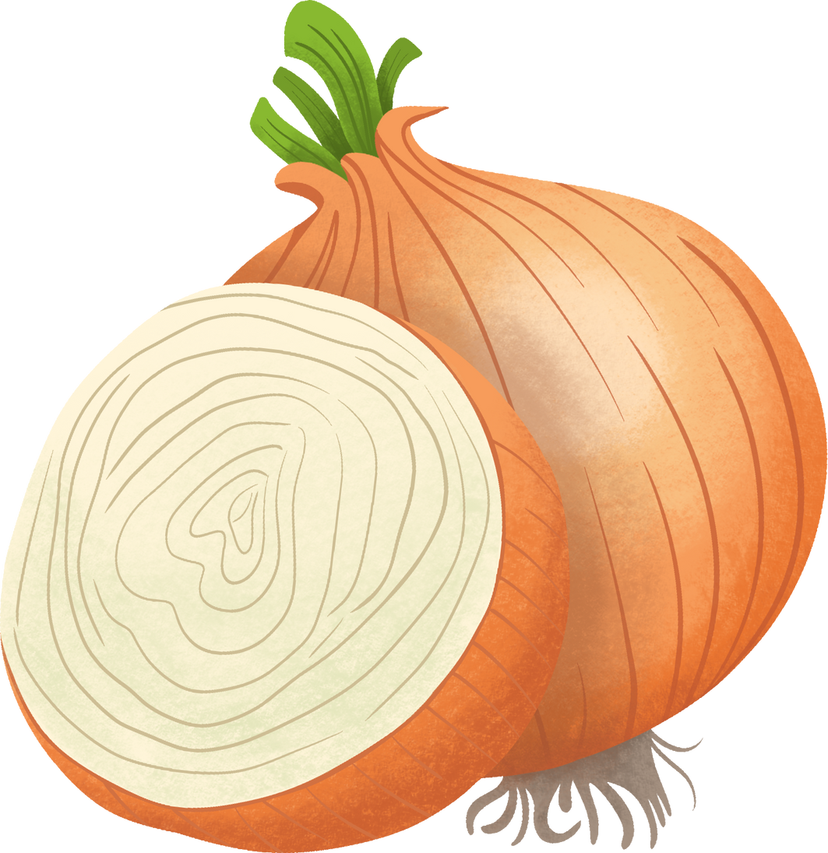
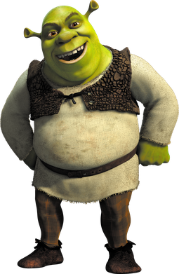

Slide 10
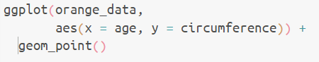
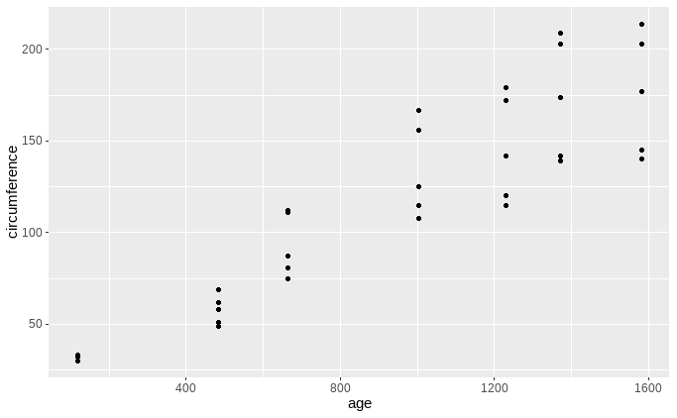
only dataset variables inside aes()
1.1
Notes:
Veranderen naar appelsienen
1.1

Slide 11


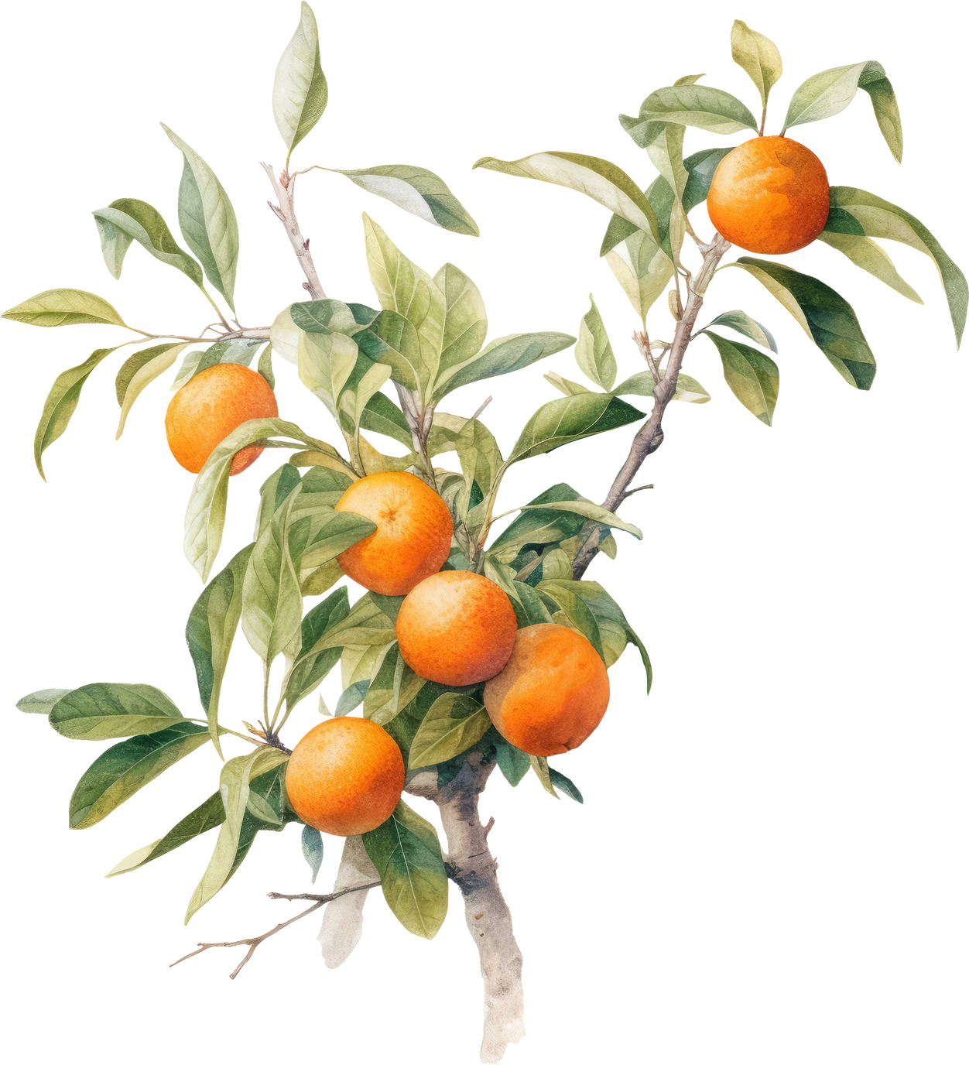
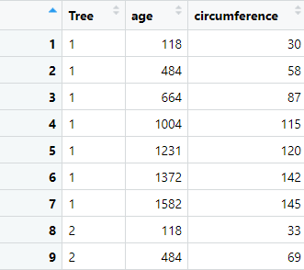
DATA
1.1 - 1.4

Slide 12

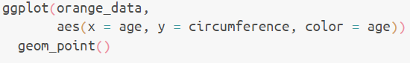
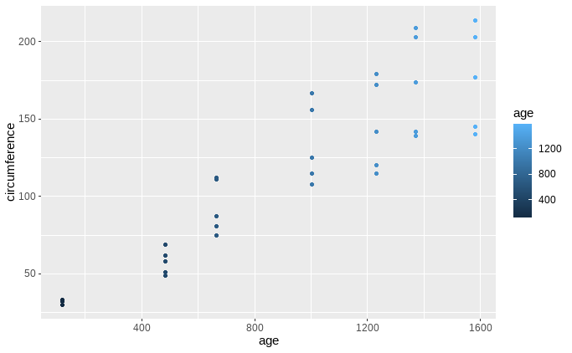
AESTHETICS
1.2
Notes:
Veranderen naar appelsienen
links: 1.2
rechts: 1.3 met bollen

Slide 13
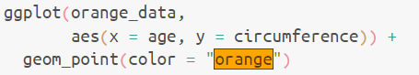
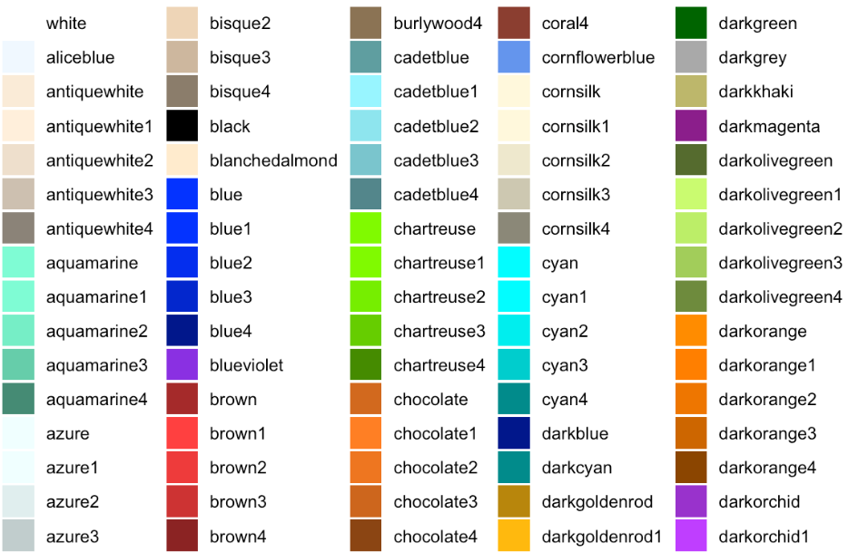
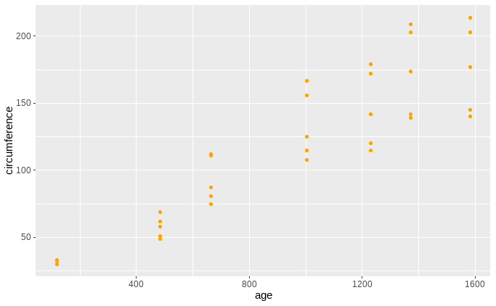
AESTHETICS
colour outside aes()
1.3
Notes:
Veranderen naar appelsienen (moeten ze zelf runnen)
1.3 (zelf invullen), enkel grafiek, geen code

Slide 14
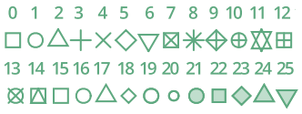
AESTHETICS
colour
fill (for the shapes 21-25)
alpha (opacity)
linetype
size (in mm)
linewidth (in mm)
shape
0 = "blank"
1 = "solid"
2 = "dashed"
3= "dotted"
4 = "dotdash"
5 = "longdash"
6 = "twodash"

Slide 15
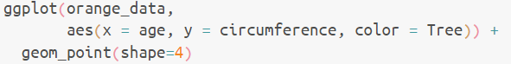
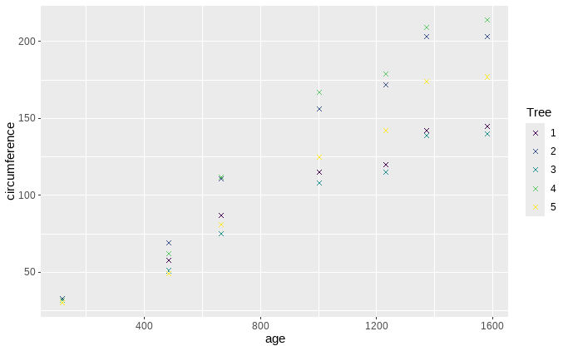
1.4
Notes:
Veranderen naar appelsienen:
1.5 invoegen met kruisjes, maar vorm mag naar keuze

Slide 16



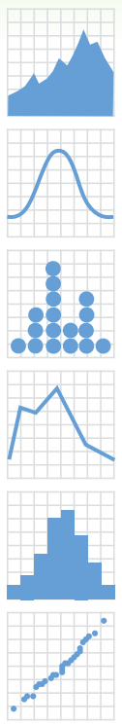
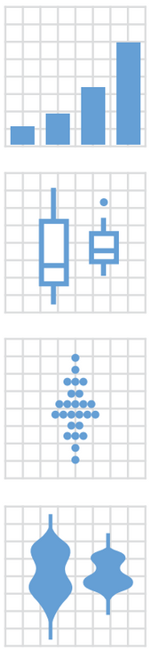
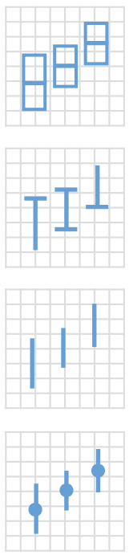

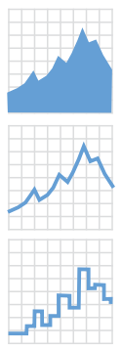

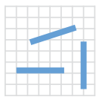
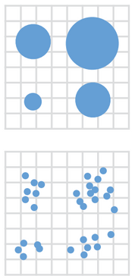

GEOMETRIES

Slide 17
geom_point()
geom_line()
geom_bar()
geom_histogram()
geom_boxplot()
geom_smooth()
geom_density_2d()
geom_density_ridges()
....
https://www.sthda.com/english/wiki/be-awesome-in-ggplot2-a-practical-guide-to-be-highly-effective-r-software-and-data-visualization#other-types-of-graphs

Slide 18
DATA
2.1 - 2.2

Slide 19
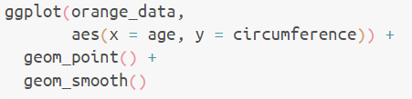
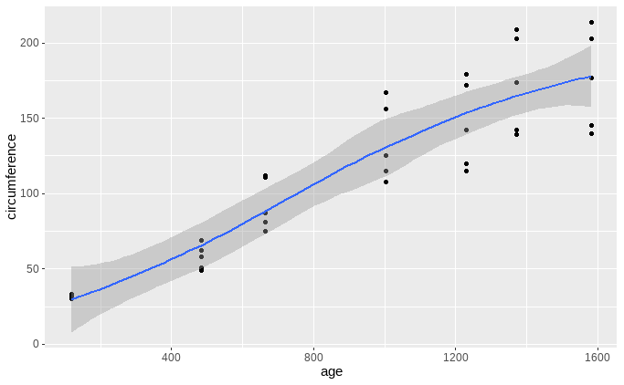
2.1
Notes:
appelsienen:
2.1(add smoother)
2.2 boxplot

Slide 20
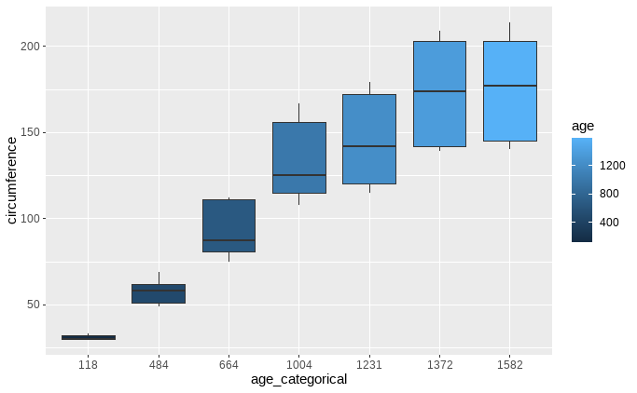
2.2

Slide 21
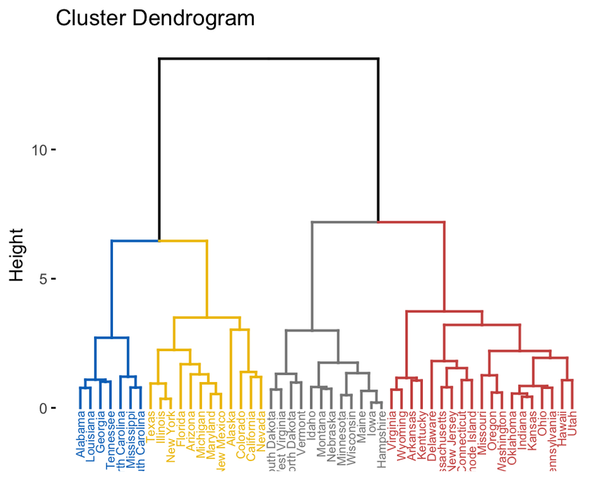

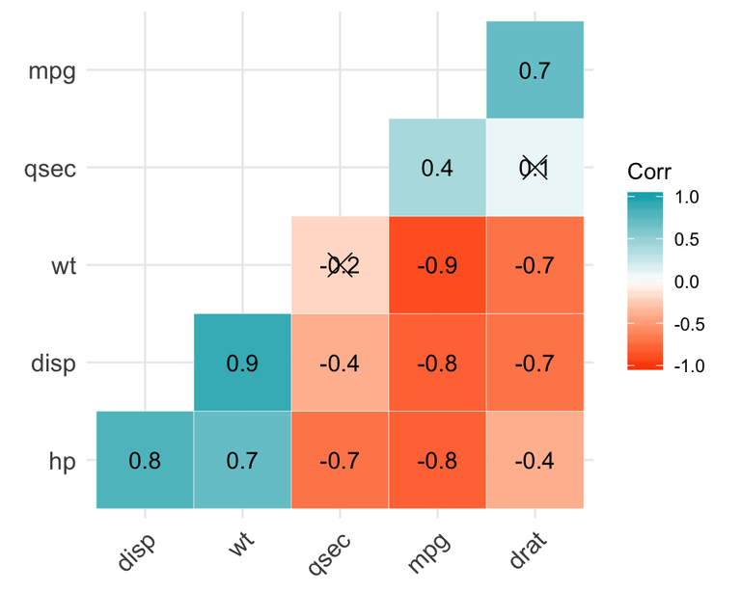
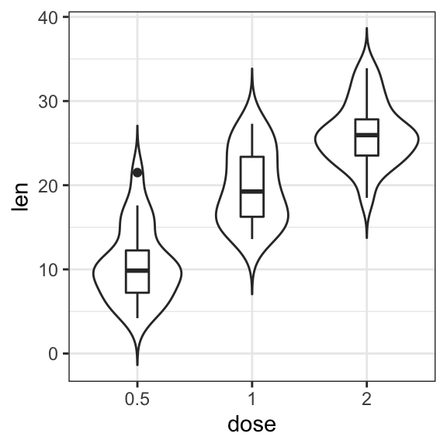
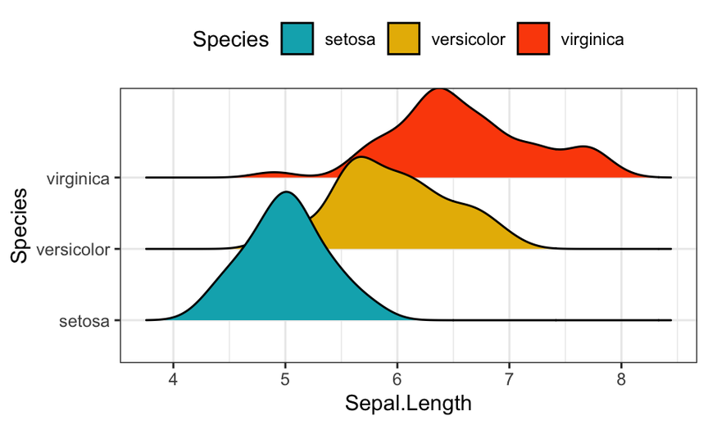
correlation matrix
violin plots
density plots
https://www.datanovia.com/en/blog/ggplot-examples-best-reference/

Slide 22
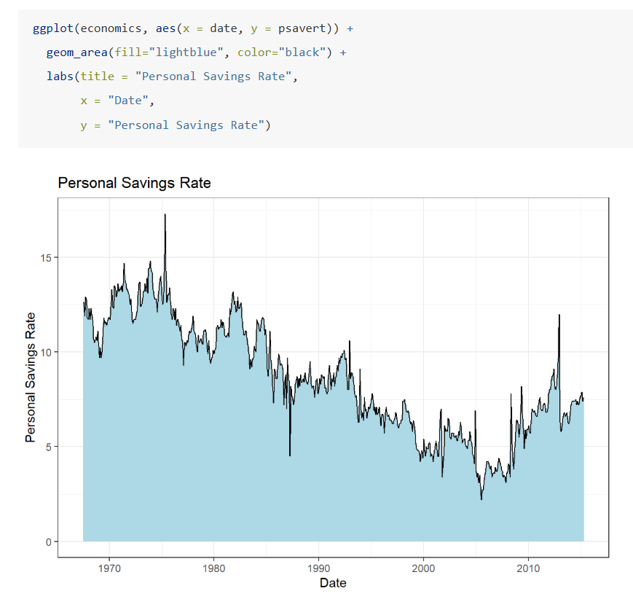
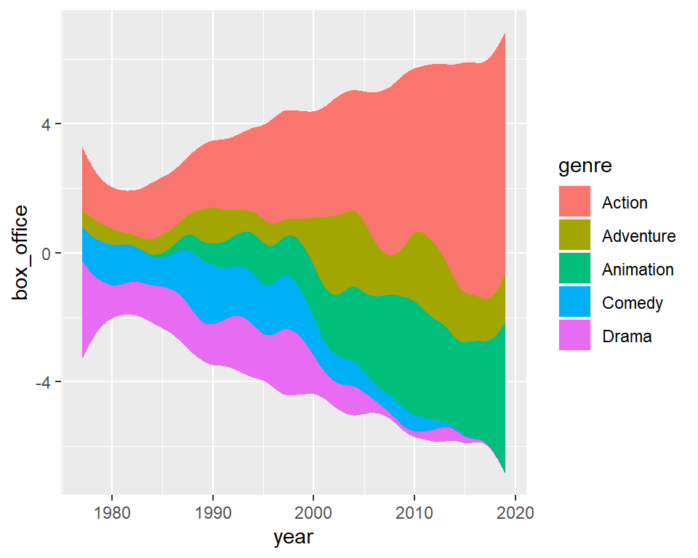
ggplot(blockbusters, aes(x = year, y = box_office, fill = genre)) + geom_stream()
https://r-charts.com/evolution/ggstream/

Slide 23
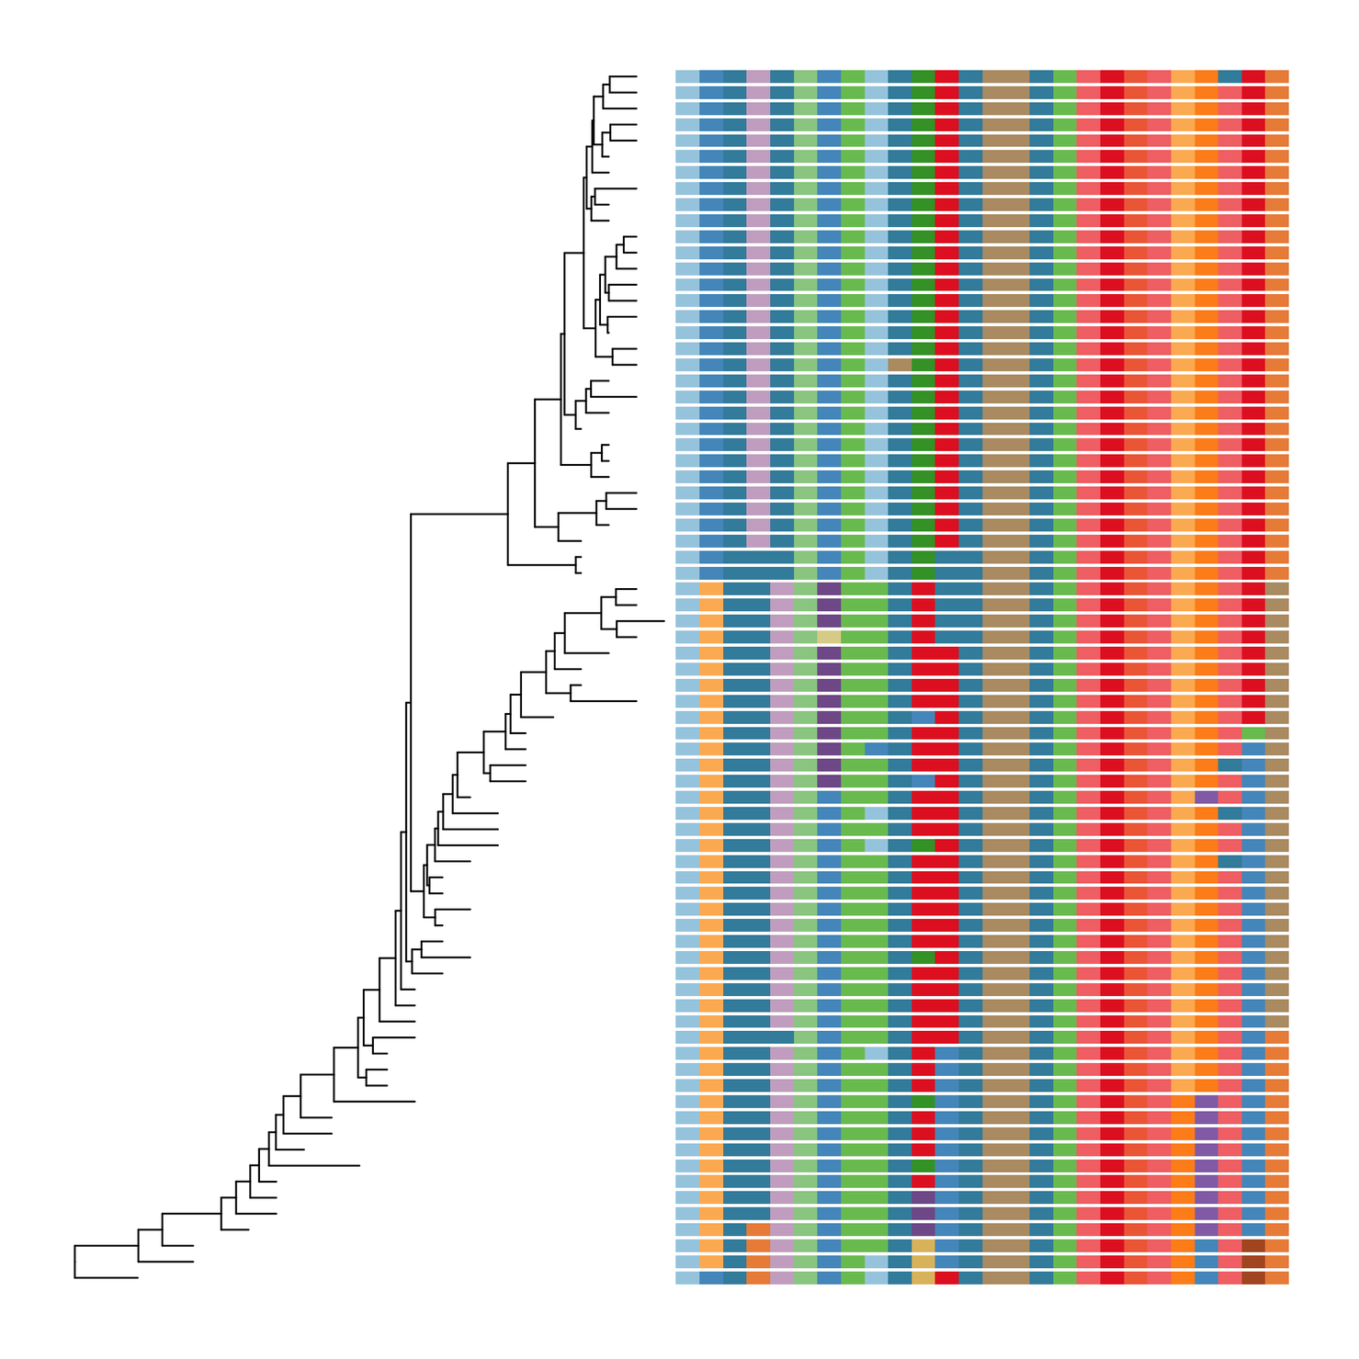
https://4va.github.io/biodatasci/r-ggtree.html
dendrogram + values

Slide 24





FACETING
The facet defines how data is split among panels.
facet_grid(. ~ A)
facet_grid(B ~ .)
facet_grid(A ~ B)
facet_wrap(~ A)

Slide 25
DATA
2.3 - 2.4

Slide 26
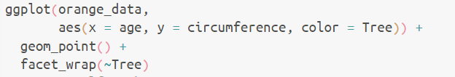
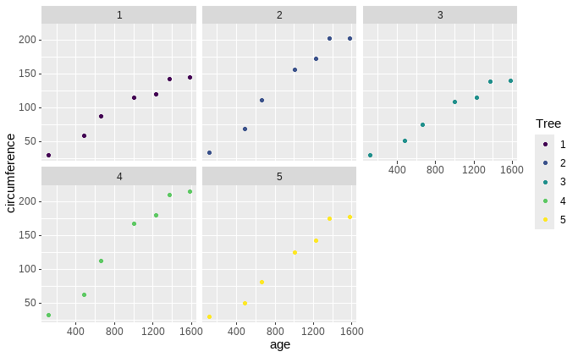
2.3
Notes:
Veranderen naar appelsienen
2.3 zelf proberen

Slide 27
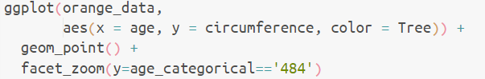
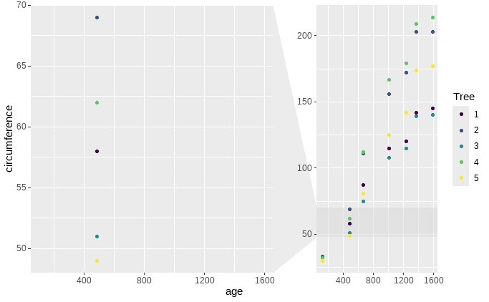
2.4
Notes:
Veranderen naar appelsienen
inzoomen op leeftijd = 484j
2.4 gewoon tonen

Slide 28

STATISTICS I
Every geometry has its own build-in statistic.
geom_bar()
default = “count”, also “summary”
after_stat() allows you to map an aesthetic (like fill, color, y, etc.) to a variable that is calculated by the statistical transformation.
use/visualize computed values in your plot
Notes:
Veranderen naar appelsienen
3.1 geven

Slide 29
DATA
3.1

Slide 30
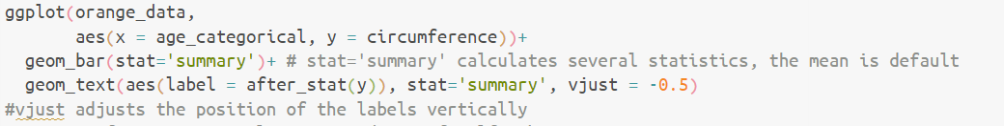
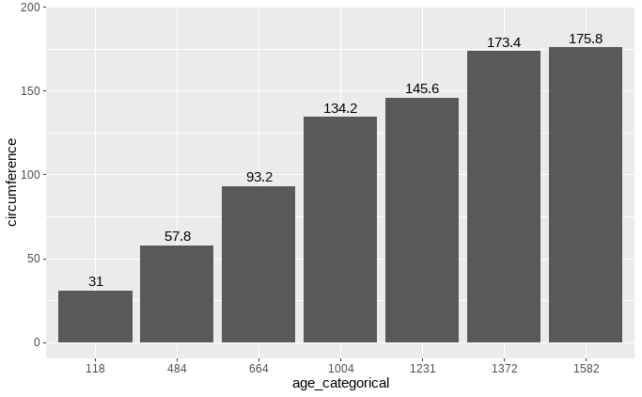
3.1
Notes:
3.1 maken
(uitleg geven over labels)

Slide 31
STATISTICS II
geom_smooth() or stat_smooth()
default = “loess”
linear
polynomial
binomial
poisson
Notes:
Veranderen naar appelsienen

Slide 32
DATA
3.2 - 3.3

Slide 33
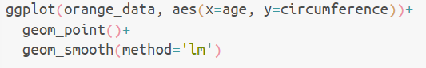
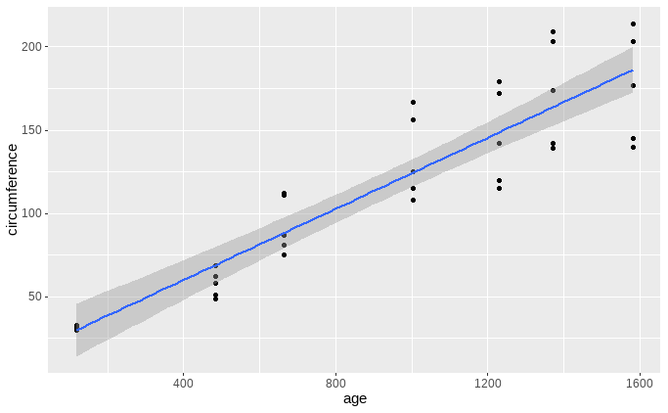
STATISTICS II
3.2
Notes:
Veranderen naar appelsienen
3.2

Slide 34
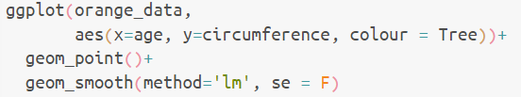
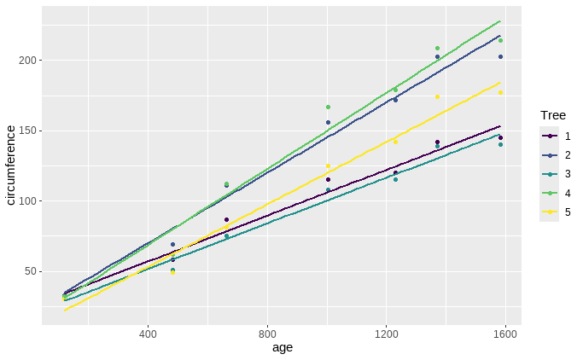
STATISTICS II
3.3
Notes:
Veranderen naar appelsienen
3.3

Slide 35
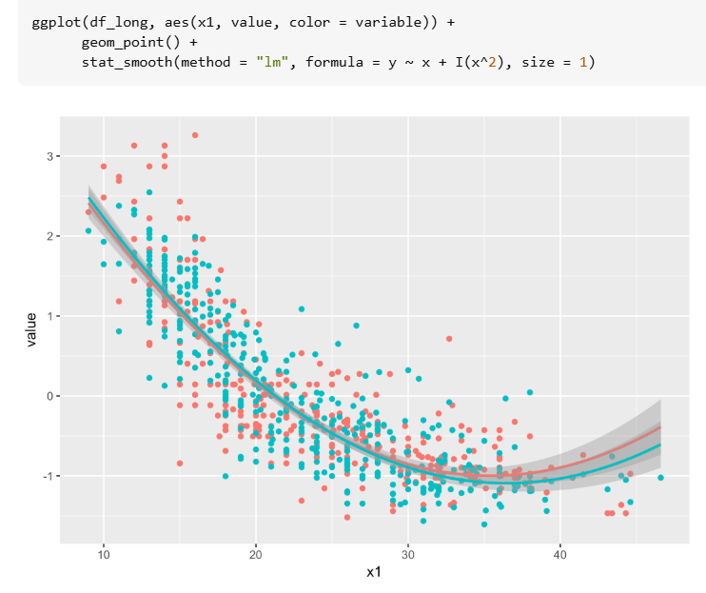
STATISTICS II

Slide 36
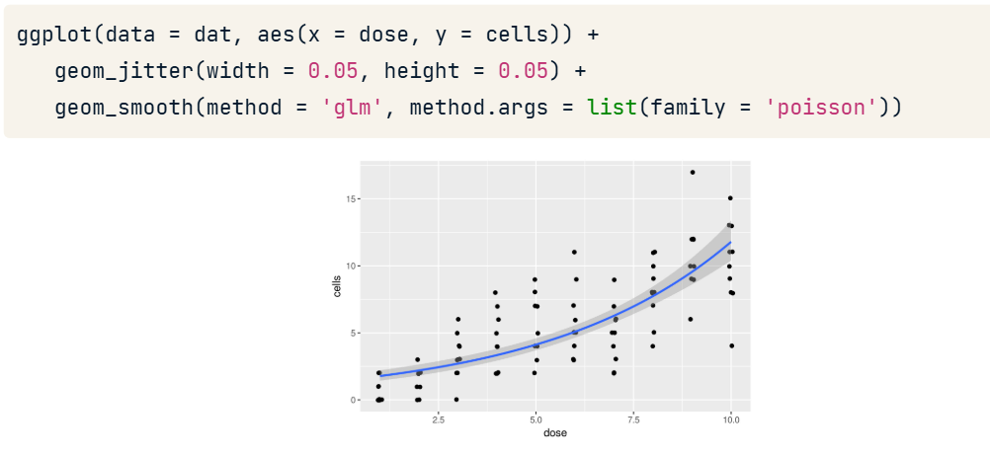
STATISTICS II

Slide 37
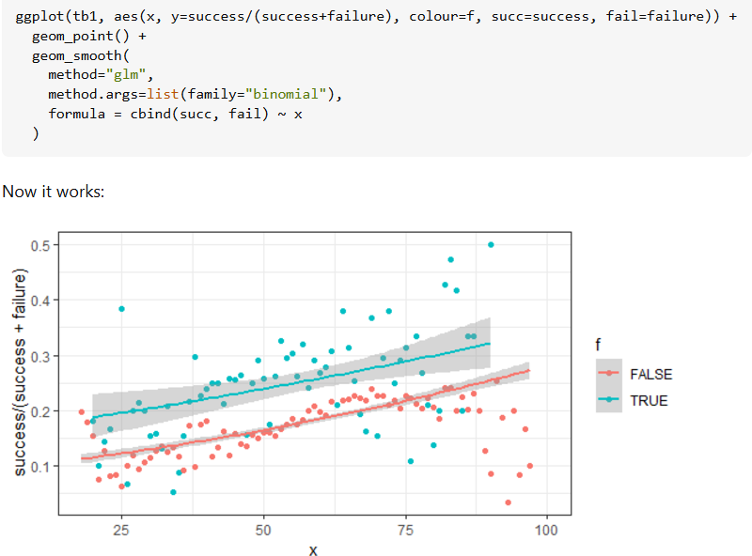
STATISTICS II

Slide 38

STATISTICS II
ggplot(gfg, aes(x, y)) +
geom_point() +
geom_errorbar(aes(ymin = low, ymax = up))
CI values are inserted manually,
eg. by confint(model, level=0.95)
https://www.geeksforgeeks.org/how-to-plot-a-confidence-interval-in-r/
Notes:
Veranderen naar appelsienen
geom_error_bar

Slide 39

STATISTICS III
https://www.sthda.com/english/articles/31-principal-component-methods-in-r-practical-guide/112-pca-principal-component-analysis-essentials/#biplot
https://chrischizinski.github.io/rstats/vegan-ggplot2/
more in-dept focus on multivariate stats + visualization with Charlotte VD

Slide 40


COORDINATES
coord_cartesian() default
coord_fixed()
coord_flip()
coord_polar()
coord_trans() -> for data that isn’t transformed
coord_sf()
https://ggplot2-book.org/coord

Slide 41
DATA
4.1

Slide 42


4.1
Notes:
4.1

Slide 43


when you work with circular data
time
directions
Notes:
projecteren

Slide 44




THEMES
theme_bw()
theme_gray()
theme_dark()
theme_classic()
theme_light()
theme_linedraw()
theme_minimal()
theme_void()
labs(x = "New x axis label",
y = "New y axis label",
title ="Add a title above the plot",
subtitle = "Add a subtitle below title",
caption = "Add a caption below plot",
alt = "Add alt text to the plot")

Slide 45
DATA
4.2 - 4.4

Slide 46


4.2
Notes:
4.2

Slide 47



THEMES
ggsci
RColorBrewer
wesanderson
“color palettes inspired by scientific journals,
data visualization libraries,
science fiction movies, and TV shows”
https://nanx.me/ggsci/
mainly discrete data

Slide 48


https://www.datanovia.com/en/blog/top-r-color-palettes-to-know-for-great-data-visualization/

Slide 49


THEMES
4.3
Notes:
Veranderen naar appelsienen
4.3

Slide 50


4.4
Notes:
4.4

Slide 51



SOME
FANCY EXTRAS

Slide 52

SHOWTEXT
download font (.ttf or .otf)
“showtext”
library(showtext)
font_add(family = "ggfont", regular = "./HelloSpark.ttf")
ggplot(...) +
theme(text=element_text(family="ggfont", size = 20))

Slide 53



PATCHWORK
https://patchwork.data-imaginist.com/

Slide 54




GGANIMATE
https://gganimate.com/articles/gganimate.html

Slide 55
GGSAVE
ggsave("./path/mtcars.png", width = 4, height = 4)
ggsave("./path/mtcars.pdf", width = 20, height = 20,
units = "cm")

Slide 56

PART 3
COMMON ERRORS & ISSUES

Slide 57

no double axes (Wickham is strongly against it)
color schemes are too short for #variables
tip: make your own palette (code)
data format issue (facets, multiple lines)
rows or columns? (dplyr)
class of your data (factor versus numeric)
... sometimes Powerpoint/Inkscape are easier

Slide 58


PART 4
YOUR TURN!

Slide 59



Dataset from the London Firebrigade
Number of rescues of animals over the years
Task: visualize the answers to the questions in the .Rmd file

Slide 60


1.1

Slide 61


1.2

Slide 62


1.3

Slide 63


1.4

Slide 64

Dataset from 3 species of penguins in the Antarctic region (advanced excercises)
Task: remake the graphs in the following slides

Slide 65

2.1 Violin plot
Notes:
plots hier zetten

Slide 66


2.2 Scatter plots with linear regression line
Notes:
plots hier zetten

Slide 67

2.3 Boxplot, 2 factors
Notes:
plots hier zetten

Slide 68

2.4 Boxplot, facets
Notes:
plots hier zetten

Slide 69

2.5 Correlation matrix
Notes:
plots hier zetten

